Slide 1
Business, Marketing, Entrepreneurship, Digital Marketing, and Econ Mrs. SchAfer

Slide 2
Teamwork
The Aristotle Project
Group Dynamics: Forming, Storming, Norming, Performing, Adjourning
Abilene Paradox – Mismanaged Agreement
Groupthink
December Precept
Notes:
https://www.youtube.com/watch?v=HM-XyALCGXM

Slide 3

The Aristotle Project
Several years ago Google created The Aristotle Project to discover what made some teams work so much better than others.
What do you think the answer was?

Slide 4
The Aristotle Project – The Answer!
Effectiveness was, surprisingly, not strongly correlated with how well the team members liked or knew each other.
It was, however, strongly connected to how well the leaders created ‘psychological safety’.
The study then identified the key ways leaders created this safety.
One way was by establishing widely accepted group norms, written and unwritten behaviors that guided relationships.
These norms were always connected to a greater sense of collective purpose.

Slide 5
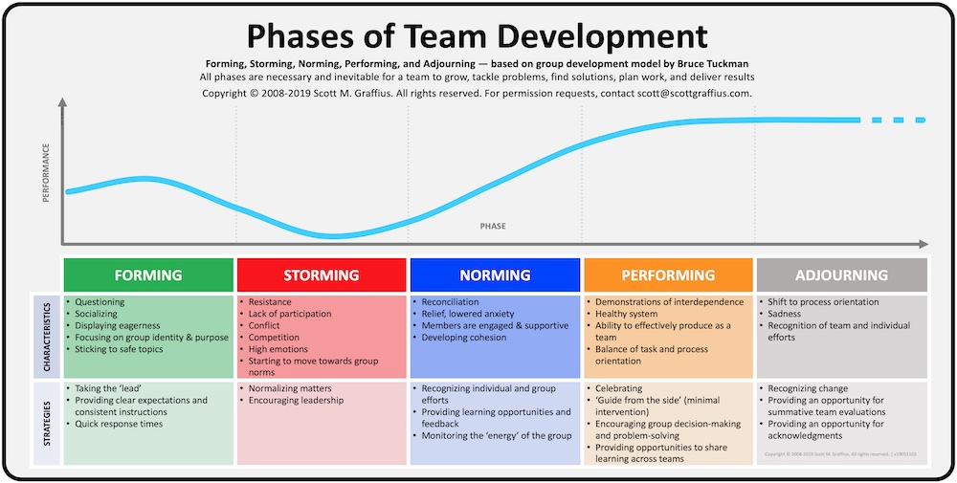
Tuckman’s Stages of Group Development
Proposed by psychologist Bruce Tuckman in 1965
Tuckman said all phases are necessary and inevitable for team to grow and deliver results

Slide 6
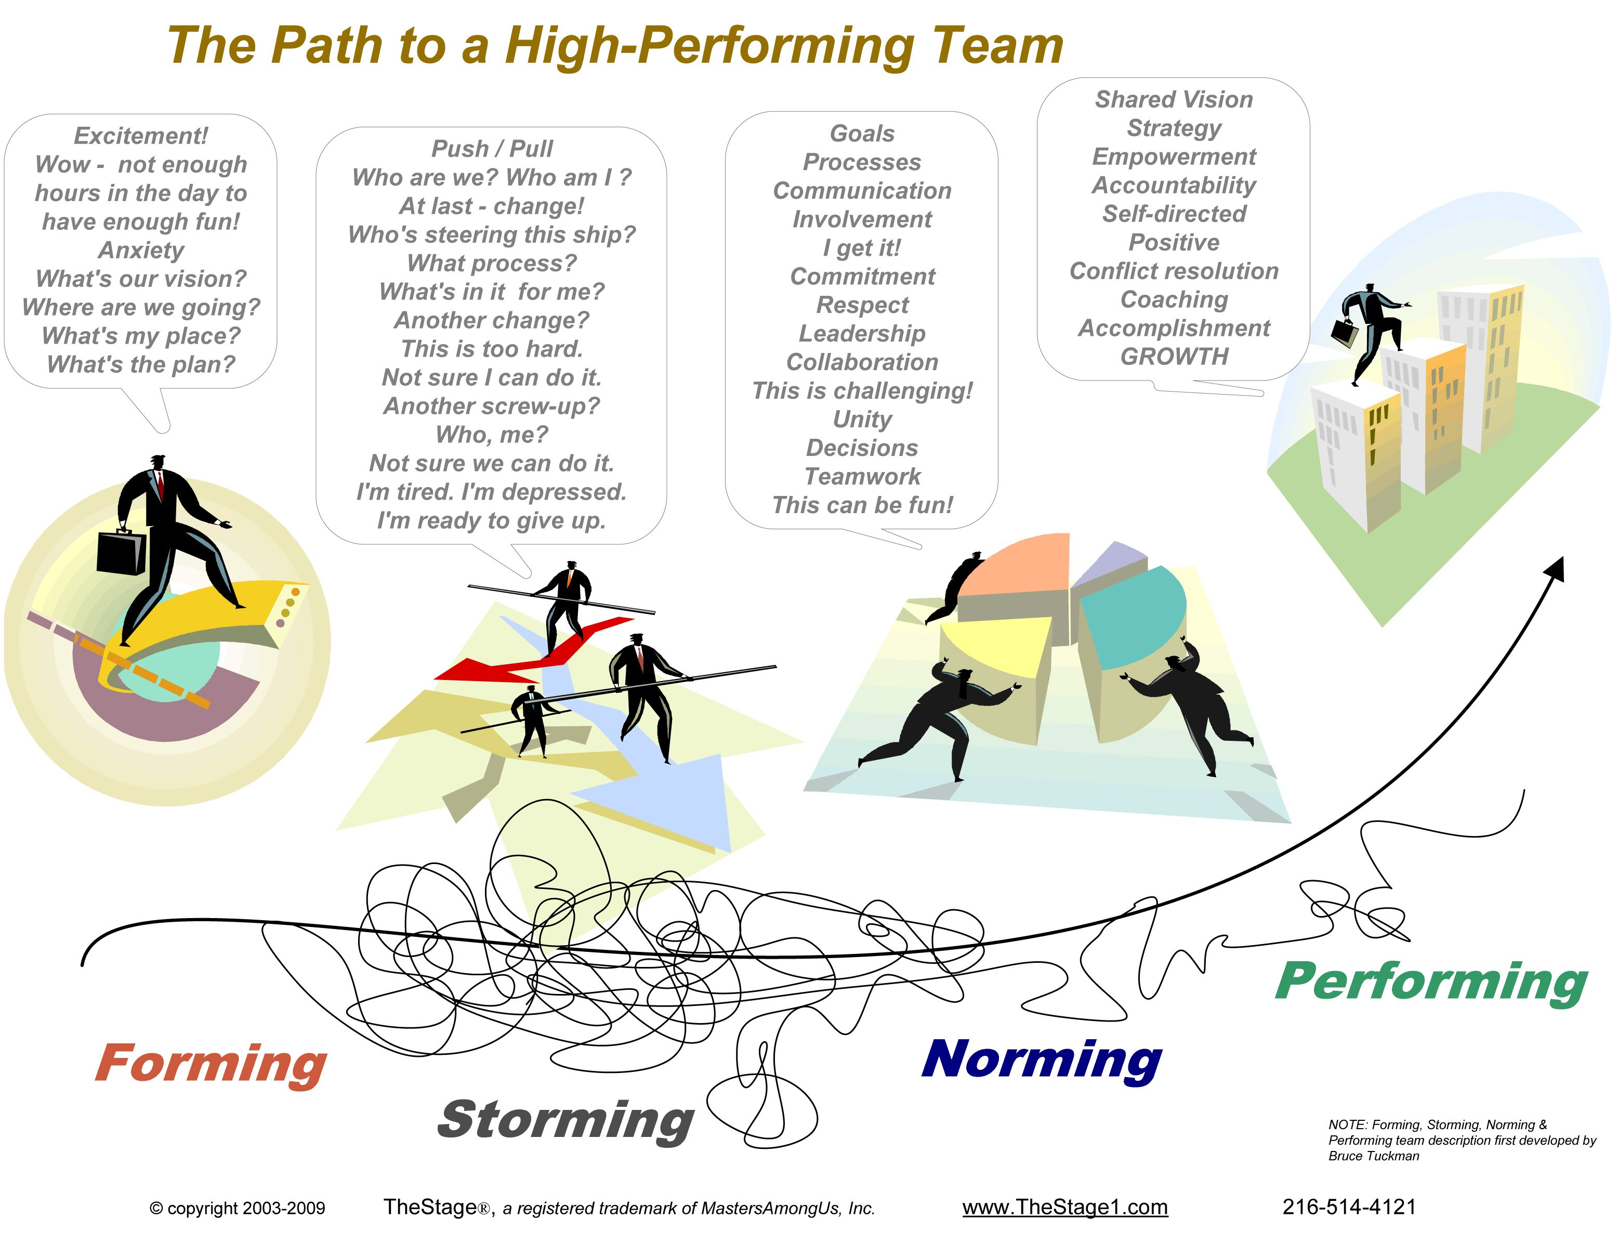

Slide 7

Turn to your neighbor
Discuss a past group project from another class.
What stage do you think your group got to?
Forming?
Storming?
Norming?
Performing?
Share strategies for how you think the group could have progressed further.

Slide 8
Turn to someone who wasn’t in your SWOT group from Q1
Discuss how your SWOT group performed.
What stage do you think your group got to?
Forming?
Storming?
Norming?
Performing?
Share strategies for how you think the group could have progressed further.

Slide 9

The Abilene Paradox was introduced by Jerry B. Harvey, Professor of Management at George Washington University in 1988
Notes:
https://www.youtube.com/watch?v=HM-XyALCGXM&t=12s

Slide 10
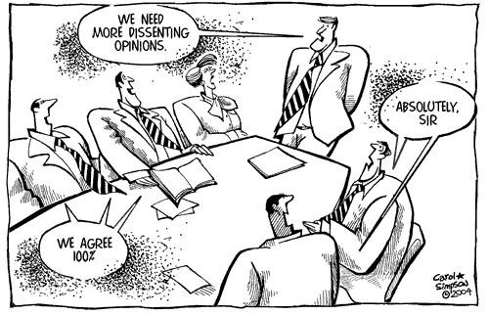
Groupthink: psychological phenomenon that occurs within a group of people in which the desire for harmony in the group results in irrational or dysfunctional decision-making
Groupthink can lead to:
Collective rationalization
Lack of personal accountability
Pressure to give acceptance
Bad decision-making
Serious ethical breaches
Insufficient creativity
Self censorship
Illusion of invulnerability
Low probability of success

Slide 11
Difference between Groupthink and Abilene Paradox
Abilene Paradox is when groups make ineffective decisions that are contrary to what each of the group members individually believe because they don't want to 'rock the boat’
With groupthink, on the other hand, the individuals are unaware that the team's decision is wrong or risky
Abilene:
Individuals know the idea is bad but don’t do anything to stop it from moving forward
Groupthink:
Individuals don’t know they’re making a bad decision

Slide 12


Slide 13

Ways to reduce Abilene Paradox
Speak up about what you really want!

Slide 14
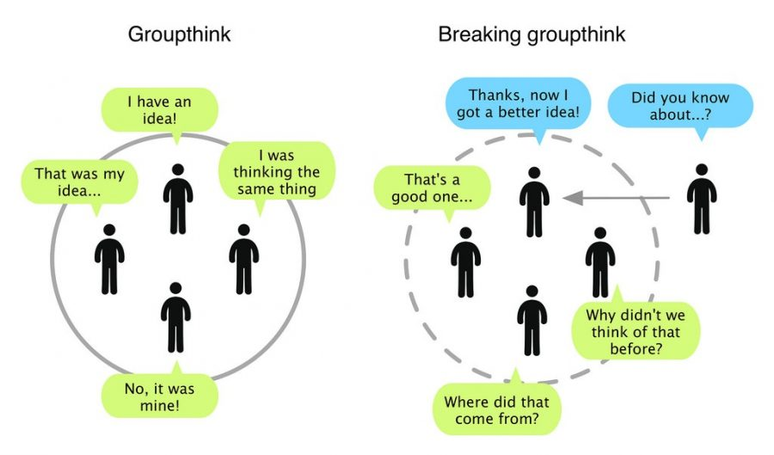
Ways to reduce groupthink…
Set expectations when forming group: say that debate is encouraged and for everyone to be a critical evaluator
Avoid the leader stating a preference up front
Diversify teams
Ask for customer or user feedback
Use outside research
Appoint a devil’s advocate
Create safe environment for people to speak up

Slide 15

December Precept
December: "Fortune favors the bold." —Virgil
This Photo by Unknown Author is licensed under CC BY-NC

